Slide 1
SCADA
Supervisory control and data acquisition (SCADA) is a control system architecture comprising computers, networked data communications and graphical user interfaces for high-level supervision of machines and processes.
It also covers sensors and other devices, such as programmable logic controllers, which interface with process plant or machinery.
The SCADA concept was developed to be a universal means of remote-access to a variety of local control modules, which could be from different manufacturers and allowing access through standard automation protocols.
In practice, large SCADA systems have grown to become very similar to distributed control systems in function, while using multiple means of interfacing with the plant.
They can control large-scale processes that can include multiple sites, and work over large distances as well as small distance.
It is one of the most commonly-used types of industrial control systems

Slide 2
SCADA
SCADA system is an important factor of the industrial organization as they help to monitor process data as well as control the processes and easily detect any issue within the process thus reduce downtime.
Generally, SCADA is completely a software package that helps to monitor the entire area of the plant.
The basic architecture of the SCADA begins with a Programmable Logic Controller(PLC) or Remote Terminal Units(RTUs).
PLC or RTUs are microprocessors that communicate with the field devices such as valves, pumps, sensors, HMIs, other end devices, etc.
These devices route all this collected data from end devices to SCADA computers.
Then SCADA software processes distribute and display the data on the monitor to better understand the operator about the field condition.

Slide 3
SCADA

Slide 4
FUNCTIONS OF SCADA
DATA ACQUSITION :Furnishes status information & measured data to operator
CONTROL :Allows the operator to control the devices e.g. ckt breakers, Xmer, tap changer etc. from a remote centralize location.
DATA PROCESSING :Includes data quality & integrity check, limit check, analog value processing etc.
TAGGING: Operator identifies any specific device & subjects to specific operating restrictions to prevent from unauthorized operation
ALARMS :Alerts the operator of unplanned events & undesirable operating conditions in the order their severity & criticality
LOGGING :Logs all operator entries, alarms &selected entries
TRENDING :Plots measurements on selected scale to give information on the trends e.g. one minute, one hour etc.
HISTORICAL REPORTING :To save & analyze the historical data for reporting, typically for a period of 2 or more years & to archive.

Slide 5
Types of SCADA System
SCADA systems are classified into four types which include the following.
• Monolithic SCADA Systems
• Distributed SCADA Systems
• Networked SCADA Systems
• IoT SCADA Systems

Slide 6
MONOLITHIC SCADA
Monolithic SCADA systems are called as early or first-generation systems.
In these types of systems, minicomputers are used.
The development of these systems can be done when common network services are not available.
The designing of these systems can be done like independent systems without any relation to other systems.
The data can be gathered from all RTUs using a backup mainframe.
The main functions of these first-generation systems are restricted to flagging processes in crisis cases &to monitor the sensors.

Slide 7
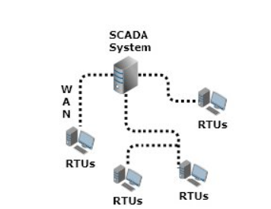
MONOLITHIC SCADA

Slide 8
Distributed SCADA Systems
Distributed SCADA systems are called second-generation systems.
The distribution of the control functions can be done across numerous systems by connecting with a local area network.
The control operations can be performed by sharing real-time data & command processing.
In these types of systems, the size and cost of each station are reduced however there were no consistent network protocols.
As the protocols were proprietary, fewer people understand the SCADA system security while installation & this factor were ignored largely.

Slide 9
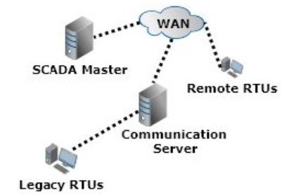
Distributed SCADA Systems

Slide 10
Networked SCADA System
The networked SCADA systems are also known as third-generation systems.
The networking and communication of SCADA systems can be done using the WAN system through data lines or phones.
The data transmission among two nodes can be done with the help of Ethernet or Fiber-optic connections.
This type of SCADA system uses PLC to adjust and monitor the flagging operations simply once there is a necessity for main choices.

Slide 11
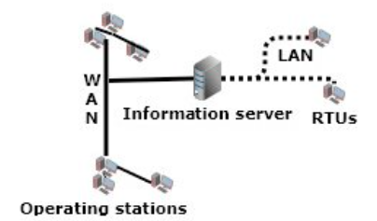
Networked SCADA System

Slide 12
IoT SCADA System
IoT SCADA systems are fourth-generation systems.
In these systems, the system’s infrastructural cost is reduced by implementing IoT through cloud computing.
Maintaining as well as integrating these systems is easy as compared with others.
In real-time, the condition of these systems can be reported through cloud computing.
Therefore, the implementation of algorithms like intricate control can be done that are frequently used on usual PLCs.

Slide 13
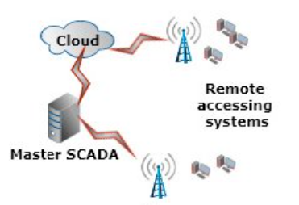
IoT SCADA System

Slide 14
SCADA System Architecture

Slide 15
SCADA System Architecture
SCADA system is a centralized system that monitors and controls the entire area.
It is a pure software package that is positioned on top of the hardware.
A supervisory system gathers data on the process and sends the commands control to the process.
The SCADA is a remote terminal unit which is also known as RTU.
The SCADA system utilizes a WAN and LAN networks; the WAN and LAN consist of internet protocols used for communication between the master station and devices.
The physical equipment like sensors connected to the PLCs or RTUs.
The RTUs convert the sensor signals to digital data and sends digital data to the master.

Slide 16
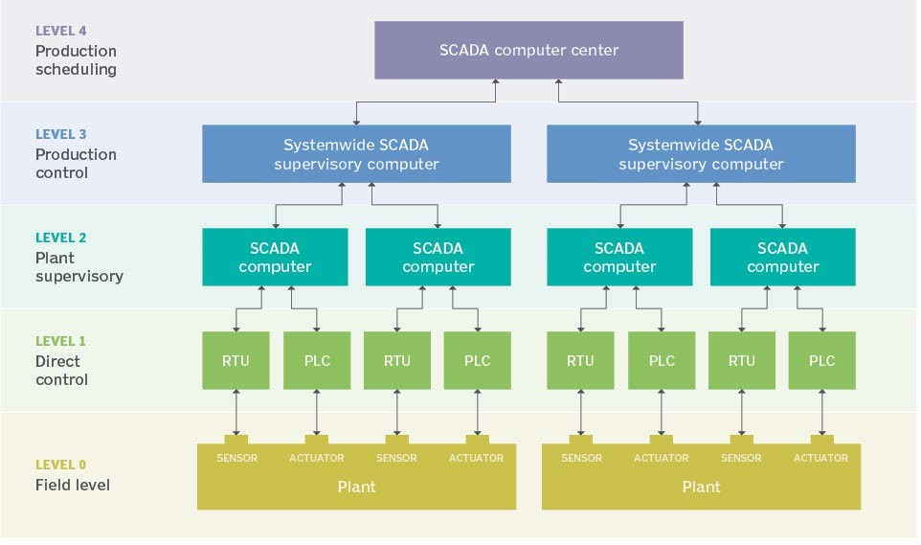
Layers of SCADA System Architecture
open control SCADA network architecture

Slide 17
Level 0
The ground-level/ field level devices that actually interact with the physical environment or work as technicians in a supervision system
Sensor is a device that can sense the physical changes around it and generate appropriate electrical or electronic signals.
The actuator is a device that makes physical changes when an electrical or electronic signal is applied to it.
Level 1
PLC(Programmable Logic Controller) and RTU(Remote Terminal Unit) comes under this level.
These are the devices that directly control the ground-level devices such as sensors and actuators.
The PLC helps to build the SCADA system with LAN only whereas the RTU system helps to build the SCADA system with the WAN

Slide 18
Level 2
Supervisory computers are come under this level.
All the programming devices that operate the ground-level devices are connected to these computers.
Supervisory computers are those from where the SCADA software starts working.
From these computers, the actual instructions and commands are given to do the operations.
Level 3
Coordinating computers comes under level.
Generally, these computers are connected to multiple plants. So, it can help to gather data from different plants to one place for production control

Slide 19
Level 4
It is top-level of the SCADA System.
At this level, a central computer is connected to all the plants and machinery.
Generally, this is operated and controlled by the management team.
All the data and information are collected and stored here.
Using these data and information they can take any decision.
From this computer, the management team can see all the actions and operations, etc

Slide 20
BENEFITS OF SCADA
Improved quality of service
Improved reliability
Reduced operating costs
Maintenance /Expansion of customer base
Ability to defer capacity addition projects
High value service providers
Improved information for engineering decision
Value added services
Flexible billing option
Improved customer information access
Reduced system implementation costs
Reduced manpower requirements

Slide 21
APPLICATIONS
• Comprehensive operational planning and control
• Fuel resource scheduling
• Optimum power flow
• Network security
• Economic dispatch
• Generation dispatch control

